Slide 1
Tactical Asset Allocation
July 2026
Prepared by the Investment Team
Phillip Capital Management Sdn Bhd

Slide 2
Disclaimer - Phillip Capital Management Sdn Bhd ("PCM")
The information contained herein does not constitute an offer, invitation, or solicitation to invest in any product or service offered by Phillip Capital Management Sdn Bhd ("PCM"). No part of this document may be reproduced or circulated without prior written consent from PCM. This is not a unit trust or collective investment scheme and is not an obligation of, deposit in, or guaranteed by PCM. All investments carry risks, including the potential loss of principal.
Performance figures presented may reflect model portfolios and may differ from actual client accounts' performance. Variations in individual clients' portfolios against model portfolios and between one client's portfolio to another can arise due to multiple factors, including (but not limited to) higher relative brokerage costs for smaller portfolios, timing of capital injections or withdrawals, timing of purchases and sales, and mandate change (e.g., Shariah vs. conventional). These differences may impact overall performance.
Past performance is not necessarily indicative of future returns. The value of investments may rise or fall, and returns are not guaranteed. PCM has not considered your investment objectives, financial situation, or particular needs. You are advised to consult a licensed financial adviser before making any investment decisions.
While all reasonable care has been taken to ensure the accuracy and completeness of the information contained herein, no representation or warranty is made, and no liability is accepted for any loss arising directly or indirectly from reliance on this material. This publication has not been reviewed by the Securities Commission Malaysia.
For more information, please refer to www.phillipcapital.com.my

Slide 3
Disclaimer - Phillip Mutual Berhad (“PMB”)
This publication has been prepared by Phillip Mutual Berhad (“PMB”) solely for information and private circulation only. It should not be construed as an offer or solicitation for the subscription, purchase or sale of the securities mentioned herein. Whilst we have taken all reasonable care to ensure that the information contained in this publication is accurate, it does not guarantee the accuracy or completeness of this publication. Accordingly, no warranty whatsoever is given and no liability whatsoever is accepted for any loss arising whether directly or indirectly as a result of any person or group of persons acting on such information and advice. This publication was prepared without regard to your specific investment objectives, financial situation or particular needs. Whilst views and advice given are in good faith, you should not regard the publication as a substitute for the exercise of your own judgement and should seek other professional advice for your specific investment needs or financial situations. Any past performance or predictions or forecasts mentioned in this document are not necessarily indicative of the future or likely performance of the fund manager and/or the portfolio. Investors may wish to seek advice from a financial adviser before making a commitment to invest in the portfolio. Any information, opinions and views contained and/or expressed in this report/presentation are subject to change without notice. The securities mentioned in this presentation (if any) are for illustration purpose only. No guarantee that the portfolio will invest into the securities. Reproduction of this report/presentation without our prior consent are strictly prohibited. PMB, its employees, directors, including its associates may have interest in the securities mentioned herein from time to time. In managing conflict of interest, they are subject to half yearly declaration, prior approval procedures and monitoring by our Compliance team. In the event there is a conflict between the clients’ interest and the interest of the Company, its employees, directors, including its associates, the clients’ interest shall prevail.
For more information, please refer to www.phillipcapital.com.my

Slide 4
Market Review – June 2026
MSCI Asia Pacific Ex-Japan Index underperformed the MSCI World Index, Malaysia, Indonesia, Hong Kong lagged
The MSCI Asia Pacific Ex-Japan Index (-1.7%) underperformed the MSCI World Index (-0.8%) as outsized declines in Hong Kong and Indonesia drag on the region. Philippines (+4.7%) managed to surge back up to flat year-to-date despite accelerating inflation and a weak peso. Taiwan (+3.1%) maintained its 2nd place within Asia Pacific for the 3rd month in-a-row, even as its National Development Council flagged an overheating economy for the 6th consecutive month. Singapore (+2.6%) trailed not far behind with strong electronics and wholesale trade activity supporting the economy. Hong Kong (-9.1%) suffered its biggest 1-month drop since Jan'24 even as its IPO market enjoyed an AI-driven boom from China AI and semiconductor firms. Indonesia (-7.9%) continued its stock market rout, as the government's interventionist policies and a weakening rupiah cause investor and public confidence in its leadership to wane. Malaysia (-1.1%) large caps meanwhile struggle to match the growth of tech peers on account of normalising commodity prices prompting a rerating of commodity-driven names.

Slide 5
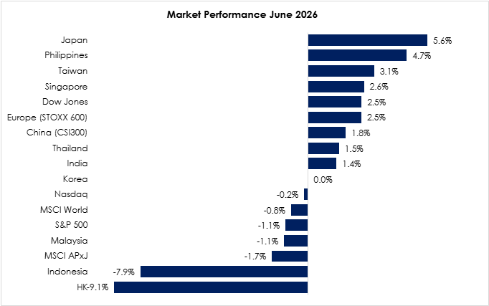
Market Review – June 2026
Malaysia, Indonesia, Hong Kong lagged
Source: Bloomberg, PCM, 30 June 2026

Slide 6
Strategy
What to look ahead?
MALAYSIA
Malaysia’s macro backdrop in June remained broadly stable, supported by improving global risk sentiment, although domestic sentiment was partly influenced by heightened political attention ahead of the upcoming general election cycle. While election-related uncertainty led to periods of volatility in domestic equities, market reaction was overall measured, reflecting expectations of policy continuity and institutional stability. Easing global energy pressures and more diversified crude supply dynamics, partly supported by shifts in Russian export flows, helped moderate inflationary pressures and support domestic price stability. Nevertheless, we remain watchful of the second order inflationary effect arising from earlier increases in energy, logistics, and labour costs which could still lingered within certain industry. Against this backdrop, we remain constructive on selected domestic-oriented sectors, particularly those linked to rising electricity demand from data centre expansion and continued momentum in renewable energy investment. We are also increasingly positive on the technology sector as visibility in order flows improves, supported by sustained AI-related capital expenditure from global leaders. Accordingly, our strategy continues to favour a barbell approach anchored on large-cap, high-quality companies with strong balance sheets and reliable dividend yields, while selectively complemented by exposure to firms with clear earnings growth potential driven by structural thematic drivers.

Slide 7
Strategy
What to look ahead?
REGIONAL
Global markets navigated a more constructive environment as diplomatic efforts in the Middle East progressed, with a conditional ceasefire between the United States and Iran and gradual reopening of the Strait of Hormuz helping to stabilise energy markets and improve investor sentiment. While the situation remains fragile and supply chain disruptions persist, the risk of a broader regional escalation has eased for now. While AI remains a key driver of demand, growth is increasingly extending into adjacent areas, including semiconductor manufacturing, advanced memory (DRAM and HBM), networking equipment, and hyperscale data centre infrastructure. This sustained investment cycle continues to support the region’s technology supply chains, reinforcing the resilience of key export-oriented economies.
Beyond the digital theme, ongoing spending in power infrastructure, grid modernisation, industrial automation, and electrification is also emerging as an important complementary driver of growth, reflecting the scale of capital investment required to support rising electricity demand and longer-term productivity improvements Against this backdrop, while sector leadership continues to be supported by structural growth in technology and industrial themes, markets are becoming increasingly selective as valuations have moved higher and are now more sensitive to earnings delivery following strong performance year-to-date.
In this environment, we believe a barbell strategy that combines growth and income exposures, alongside broader diversification, remains well positioned to navigate volatility stemming from potential energy shocks, renewed inflationary pressures, and lingering uncertainties surrounding US tariff policies.

Slide 8
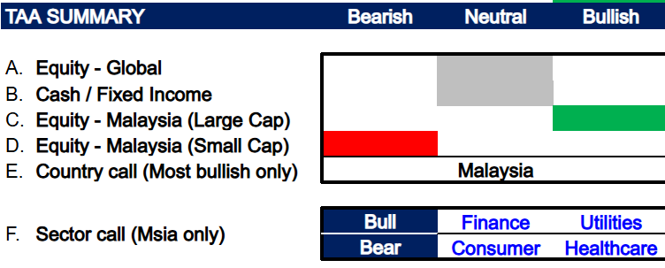
Strategy
We adopt a neutral stance on global equities, particularly the U.S., underpinned by the resilience of the U.S. economy, healthy domestic consumption, and its position as a major energy producer and net exporter. While AI valuation concerns have eased, elevated broader market valuations continue to limit upside.

Slide 9
Strategy
We adopt a neutral stance on global equities, particularly the U.S
We adopt a neutral stance on global equities, particularly the U.S., underpinned by the resilience of the U.S. economy, healthy domestic consumption, and its position as a major energy producer and net exporter. While AI valuation concerns have eased, elevated broader market valuations continue to limit upside, supporting our neutral stance. However, we remain constructive on Malaysian equities, supported by resilient domestic demand, attractive dividend yields, and improving investor sentiment amid a more supportive global rate outlook. Expectations of further monetary easing globally could provide greater policy flexibility for Asian central banks, while Malaysia’s ongoing investment cycle, particularly in infrastructure, data centres, and key domestic sectors, continues to support medium-term growth prospects.
In Malaysia, we remain bullish on large-cap equities and bearish on small-cap equities. Sector-wise, we overweight the Banking and Utilities sectors. Banking remains well positioned in a higher-for-longer interest rate environment, supported by resilient net interest margins, healthy loan growth and stable asset quality. Meanwhile, the Utilities sector is expected to benefit from its defensive earnings profile, stable cash flows and supportive regulatory framework, making it an attractive sector amid ongoing macroeconomic uncertainties. Meanwhile, we remain bearish on the Consumer sector could face margin pressures from uncertainty surrounding second-order inflation effects, as higher operating costs may be difficult to fully pass on to consumers, Healthcare sector, particularly glove manufacturers, as persistent industry oversupply and continued pressure on average selling prices (ASPs) are likely to weigh on earnings recovery.
.
Source: PCM, the stocks/sectors listed here are not to be interpreted as recommendations

Slide 10
Appendices

Slide 11
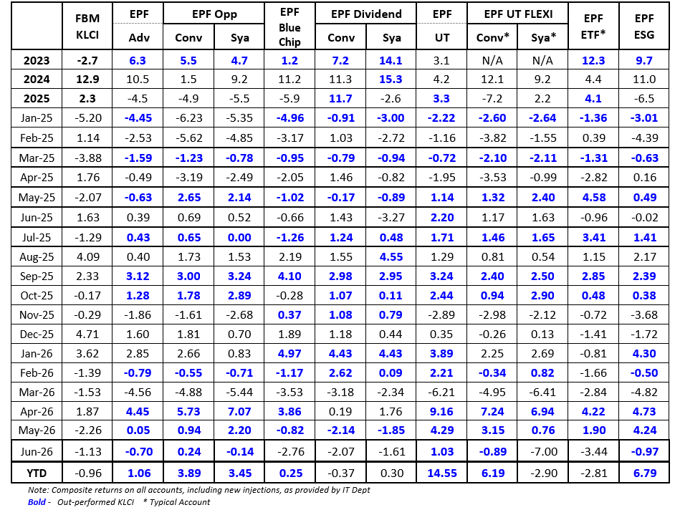
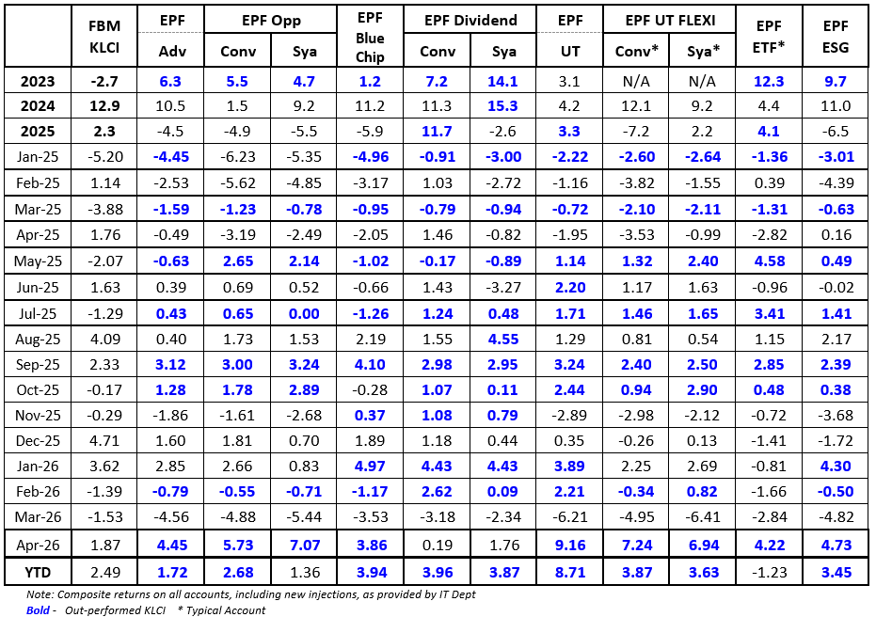
PMART Performance
Source: PCM, 30 June 2026

Slide 12
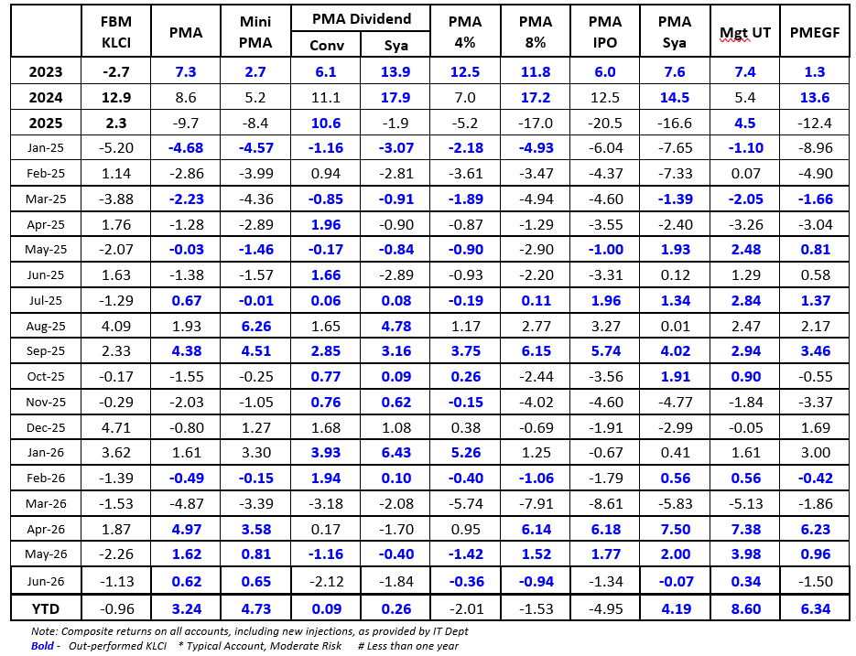
PMA Performance
Source: PCM, 30 June 2026

Slide 13
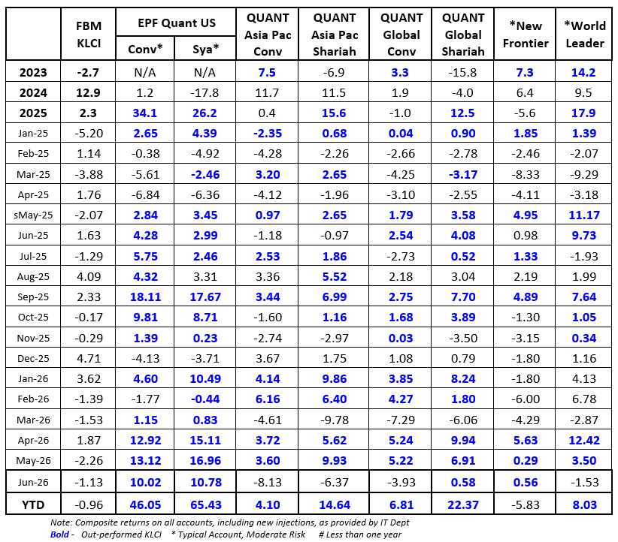
PGWA Performance
Source: PCM, 30 June 2026

Slide 14
PMB Unit Trust Fund Performance
Fund | Type | Launch Date | Fund Size (in RM'm) | 2023 Return (%) | 2024 Return (%) | 2025 Return (%) | 2026 YTD (%)
Local
Phillip Dana Aman * | Equity Malaysia | 16/4/1998 | 31 | +4.09 | +13.38 | -1.71 | -1.62
Phillip Dividend Fund | Equity Malaysia Income | 18/11/2003 | 26 | +0.95 | +10.93 | +1.39 | +3.78
Phillip Master Equity Growth Fund | Equity Malaysia | 18/6/2003 | 50 | +1.34 | +13.59 | -12.36 | +6.35
Phillip Pearl Fund | Equity Malaysia Sm&Mid Cap | 6/1/1997 | 41 | +3.72 | +20.44 | -14.49 | +6.29
Phillip Recovery Fund | Equity Malaysia | 15/4/1999 | 15 | +4.03 | +16.30 | +1.53 | +0.61
Phillip Dana Murni * | Bond MYR | 25/3/2003 | 17 | +5.50 | +3.43 | +3.95 | +1.16
Phillip SELECT Balance Fund | Mixed Asset MYR Bal - Malaysia | 11/8/2003 | 25 | +5.17 | +14.27 | -2.29 | +3.57
Foreign
Phillip Dana Dividen * (Merged w/ Dana Aman) | Equity Global Income | 26/7/2007 | 3 | +20.30 | +6.88 | +3.40
Phillip Global Disruptive Innovation Fund (Merged w/ Global Stars) | Equity Global | 22/4/2019 | 6 | +9.15 | +6.54 | +12.68
Phillip Global Stars Fund | Equity Global | 20/7/2006 | 5 | +26.60 | +9.06 | +14.68 | +13.35
Phillip AsiaPac Income Fund (Merged w/ SELECT Balance) | Mixed Asset MYR Bal - Global | 28/11/2006 | 7 | -0.49 | +7.52 | +8.27
Phillip Focus China Fund | Equity Greater China | 19/5/2009 | 11 | -16.41 | +16.67 | +16.40 | +0.27
Note: * denotes Shariah funds, Source: Lipper, PCM, 30 June 2026

Slide 15
Thank you!

Slide 16

